Slide 1


p
STUDENT DETAILS
NAME: PALAGIRI SAALIM
SKILLS BUILD EMAIL ID:palagirisaalim2122@gmail.com
COLLEGE NAME: ADITYA COLLEGE OF ENGINEERING MADANAPALLE
COLLEGE STATE: ANDHRA PRADESH
INTERNSHIP DOMAIN: Cyber Security
INTERNSHIP START DATE: 14-JUNE-2023
INTERNSHIP END DATE: 24-JULY-2023

Slide 2
TOPIC:- KEYLOGGER CAPTURING
A keylogger is a type of software or hardware device that captures and records keystrokes made on a computer or mobile device.Keyloggers, also known as keystroke loggers, are tools or software that record and capture keystrokes made on a device's keyboard. They can track and log every key pressed by a user, including passwords, sensitive information, and other text input. Keyloggers can be used for legitimate purposes such as parental monitoring or employee tracking, but they are often employed by malicious actors for illicit activities.

Slide 3
AGENDA
Keylogger Functionality and Operation
Types of Keyloggers: Software and Hardware
Detection and Prevention Techniques
Legal and Ethical Considerations.

Slide 4
PROJECT OVERVIEW
Scope:The Keylogger Capturing project aims to explore the functionality, types, detection, prevention, and legal aspects of keyloggers. It encompasses both software and hardware keyloggers, focusing on understanding their operation and capturing techniques.
Objective:The primary objective of the Keylogger Capturing project is to gain a comprehensive understanding of keyloggers and their significance in the realm of information security.
Purpose:The purpose of the Keylogger Capturing project is to raise awareness about keyloggers and their potential risks.
Overall, the Keylogger Capturing project serves as a valuable resource for individuals, organizations, and professionals seeking to enhance their understanding of keyloggers, their detection, prevention, and the ethical considerations associated with their usage.

Slide 5
WHO ARE THE END USERS ?
The end users of Key logger Capturing are System Administrators,Employers,Parents & Guardians,Law Enforcement & GOVT Agency, Ethical Hackers & Penetration ,& Cyber Criminals.The target audience for the Keylogger Capturing project consists of end users who are concerned about information security, privacy, and the potential risks associated with keyloggers.
Characteristics of the Target Audience:
Individuals: These could be regular computer users, parents, or individuals who value their privacy and want to protect their personal information from unauthorized access.
Small and Medium-Sized Enterprises (SMEs): Businesses that may have concerns about employee productivity, data leakage, and potential insider threats.
Forensic Professionals: Investigators, law enforcement agencies, or legal professionals who deal with digital forensics and require a comprehensive understanding of keyloggers for their work.
Information Security Enthusiasts: Individuals who have a keen interest in learning about the latest security threats and technologies to enhance their knowledge in the field

Slide 6
Needs of the Target Audience:
Awareness and Education: The target audience needs to understand the functionality, types, and potential risks associated with key loggers to make informed decisions about their digital security.
Detection and Prevention: Individuals and organizations need practical knowledge and techniques to identify and protect against key logger attacks, safeguarding their sensitive information.
Ethical Considerations: Users require guidance on the responsible and lawful usage of key loggers, ensuring they do not infringe on privacy rights or engage in malicious activities.
Forensic Investigation: Professionals in the digital forensics field need insights into the role of key loggers in investigations, aiding them in detecting and attributing cybercrimes.
Benefits of the Project's Solution:
Increased Security: The target audience will gain knowledge of key logger detection and prevention techniques, allowing them to protect their personal or organizational data from unauthorized access.
Enhanced Privacy: Users will understand the potential risks associated with key loggers and can take proactive measures to ensure their privacy is not compromised.
Legal Compliance: Individuals and organizations will gain insights into the legal framework surrounding key logger usage, helping them navigate the boundaries and ensure they adhere to applicable laws and regulations.
Forensic Proficiency: Forensic professionals will acquire a deeper understanding of key loggers, enabling them to effectively investigate and analyze digital evidence, particularly in cases involving unauthorized access or data breaches.
Regenerate response

Slide 7
SOLUTION AND ITS VALUE PROPOSITION
My solution to the problem of keylogger capturing is the Keylogger Capturing Toolkit. It is designed to address the needs of end users concerned about information security, privacy, and the potential risks associated with keyloggers. The toolkit provides a comprehensive set of tools, resources, and guidance to empower individuals, organizations, and forensic professionals in effectively detecting, preventing, and mitigating keylogger attacks.
How my solution brings value to the end users:
Awareness and Education:
Educational Materials: The toolkit offers in-depth educational materials, including guides, tutorials, and interactive content, to raise awareness about keyloggers and their risks.
Understanding Keylogger Types: It provides insights into different types of keyloggers, their functionality, and operation, helping users comprehend the varying threats they may encounter.

Slide 8
Detection and Prevention:
Detection Tools: The toolkit includes advanced key logger detection tools, allowing users to scan their systems for potential key logger presence and identify any suspicious activities.
Prevention Techniques: It provides a comprehensive set of prevention techniques, such as anti-key logger software recommendations, best practices for secure browsing, and tips for creating strong passwords.
Value to End Users:
Enhanced Security and Privacy: Our solution empowers end users to proactively protect their sensitive information from unauthorized access, minimizing the risk of data breaches and identity theft.
Compliance and Legal Assurance: Users gain a comprehensive understanding of legal and ethical considerations, ensuring they deploy key loggers within the boundaries of the law and respect privacy rights.
Forensic Efficiency: Forensic professionals benefit from advanced tools and techniques, enabling them to efficiently analyze key logger data during investigations, leading to more effective resolution of cybercrimes.
Peace of Mind: By equipping end users with knowledge, tools, and resources, our solution brings peace of mind, allowing individuals and organizations to confidently navigate the digital landscape without the fear of key logger threats.

Slide 9
How did you customize the project and make it your own
Customizing keylogger capturing keystrokes typically involves developing or configuring keylogger software according to specific requirements. The process may vary depending on the software or programming language used. Here are a few approaches to customize keylogger capturing keystrokes:
Software Development:
Keylogger software development involves using keyboard hooks or API-level programming to intercept keystrokes before they reach the target application. You can utilize functions like GetAsyncKeyState or GetKeyState to capture keystrokes . Additionally, you may want to consider capturing other input events, such as clipboard text, application activity, or taking screenshots, based on your customization requirements .
Configuration and Settings:
Some keyloggers offer customization options through configuration files or settings within the software itself. These options may allow you to specify which keystrokes to capture, enable or disable specific features, define logging intervals, or set up filters to exclude certain keystrokes or applications.
The extent of customization options varies depending on the keylogger software you choose. Commercial keyloggers often provide more advanced customization features compared to basic or open-source alternatives.

Slide 10
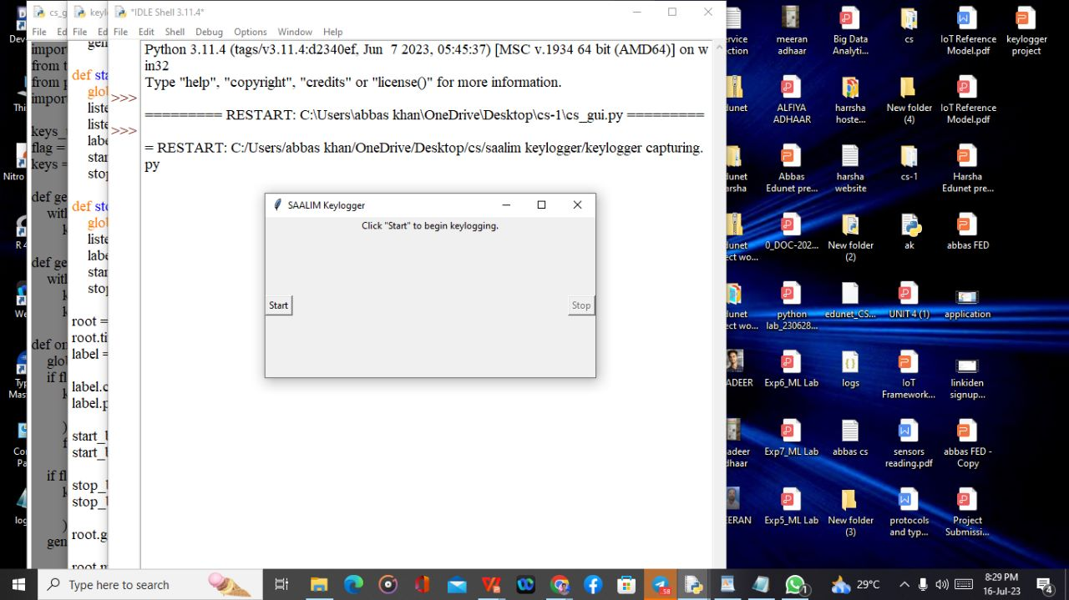
MODELLING
A user interface based key logger using tinder. It records the key strokes and creates logs for them in a file. Which can be used for different security purposes. Here are some images

Slide 11
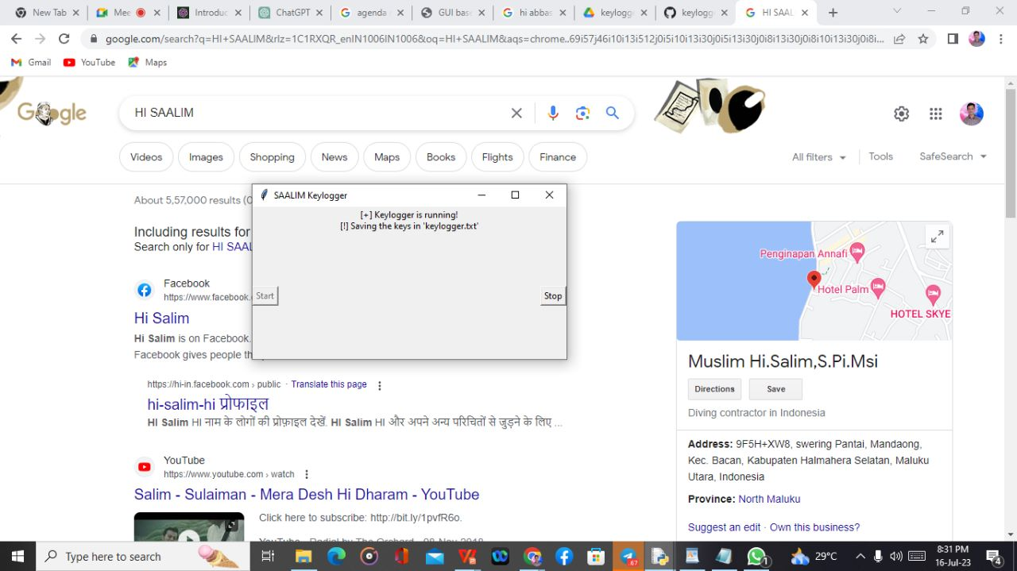
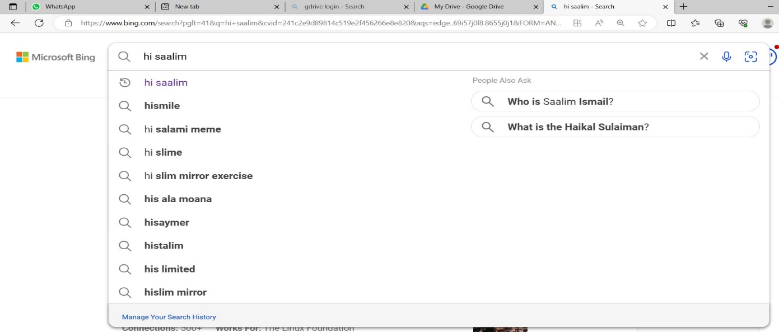
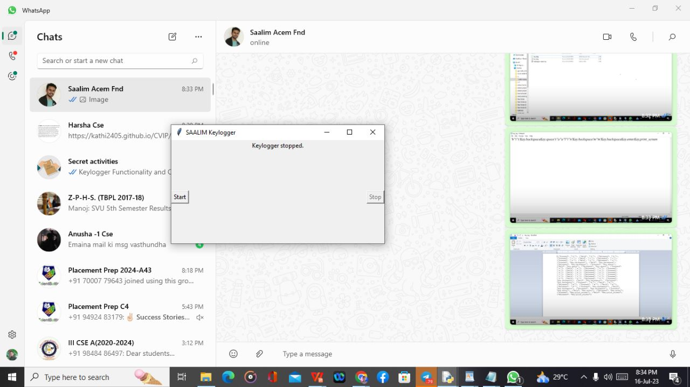

Fig 1:- Click Start Button
Fig 2:- Search anything using keyboard
Fig 3:- Click end Button
Fig 4:- Go to Respective folders and see two files are created JSON and TEXT File

Slide 12


Fig:-JSON File
Fig:- Text Files

Slide 13
Results:
Key Logger Capturing is a powerful tool that can be used for good and bad purposes.
It is important to understand the techniques used to capture keystrokes and the ethical and legal implications of using key loggers.
whether used for legal implications of using key loggers.
whether used for corporate monitoring, law enforcement, or personal,purpose,the use of keyloggers should always be done in a responsible and ethical manner.
Key loggers can pose a serious threat to computer security.
Understanding how they work, the different types, and prevention measures can help protect against them.
By being proactive and taking preventative measures, individuals and organizations can greatly reduce the risk of key logger attacks.

Slide 14
Links:
GitHub Link:
https://github.com/Palagirisaalim/Keylogger-Capturing/tree/main/saalim%20keylogger
Output Drive Link:
https://drive.google.com/drive/folders/1RraisbmplPh8De-PxJdTcDtVCCSt2biv?usp=drive_link

